Slide 1
Nonviolence and Asian Religions
Who and what do you think of?
Separating the question in Japan?
Understandings of nonviolence
Strategic vs. principled nonviolence
Social movements, campaigns and use of nonviolence
Notes:
Harmony, social cohesiveness, status quo and stability; Nonviolence is ‘the power released by the struggle to overcome a negative drive, such as anger, fear, hate…’
OED defines “nonviolent” as "not using violence
"strategic nonviolence" in contrast to what is called "principled nonviolence"—the presence of concern for the opponent as person.

Slide 2
The Constitution of Japan & Article 9
includes the notion of “the right to live in peace.”
“We desire to occupy an honored place in an international society striving for the preservation of peace, and the banishment of tyranny and slavery, oppression and intolerance for all time from the earth.”
“peace” means to eradicate issues such as autocracy, slavery, oppression, or discrimination based on narrow thinking from this earth permanently.
“We recognize that all peoples of the world have the right to live in peace, free from fear and want.”
Abolition of war
Notes:
Japan accepted peace and democracy as the state's fundamental policy at the end of
World War II in 1945. The political system was reversed by placing sovereignty in the
hands of the people under the new Constitution. Fundamental human rights were
established as inviolable, with permanent rights guaranteed by the Constitution, and
equality of all citizens assured under the law. The Constitution guarantees respect for
the individual life of each citizen, and the right to pursue freedom and to enjoy
happiness. Japan pledged to strive to establish international peace based on justice
and equity through peaceful means by renouncing all forms of military action.

Slide 3
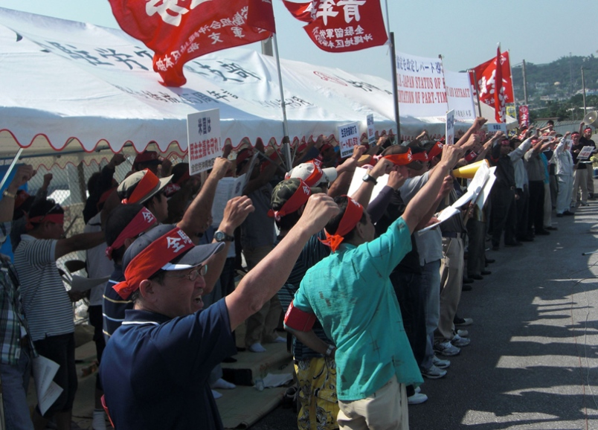
Strategic Nonviolence
2007: Zenchuro Union Strike
Anti-Nuclear Movement (3/11)

Slide 4
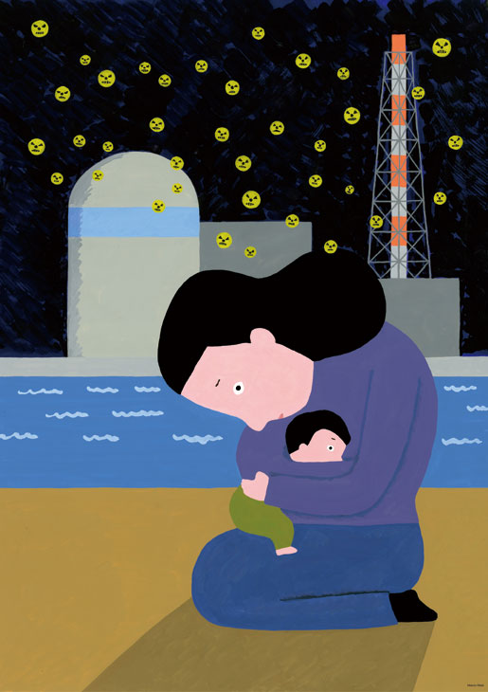
Metropolitan Coalition Against Nukes: Living in the aftermath of 3/11
ShareThis Copy and Paste
Web search
Picture: Fukushima Mother 2

Slide 5
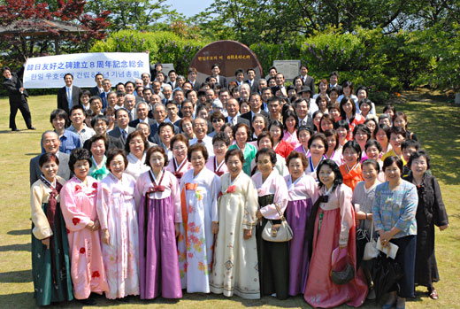
Principled Nonviolence
Soka Gakkai

Slide 6
Ogata Sadako
UNHCR High Commissioner 1990-2000
UN Commission on Human Rights
independent expert on the human rights situation in Burma
large-scale emergency operations in northern Iraq, Bosnia and Herzegovina, Kosovo, and the Great Lakes region of Africa.
internally displaced people
Refugees, peace and international security

Slide 7
TANAKA SHOZO (1841-1913)
Japanese congressman who gave all his time, energy, wealth to fight the poisoning of the rivers by the copper mines. He gave his life to protect the people from poisoning in Tochigi and the Kanto plain, Japan.
You have two choices when you see obvious wrong doing. You can allow it to continue and let it get worse, or you can stand up, speak out against the crime and eradicate it. Tyranny grows when we do nothing. But freedom grows as we stand against the evil and ACT.

Slide 8
Resources
Shinichi Yamamuro, “The Source and Development of Japan’s Philosophies of Non-Violence”, Tokyo, 2009.
Koichi Miyata, “Nonviolence and Japanese Buddhism”, 2004, http://hw001.spaaqs.ne.jp/miya33x/paper7-3.html .
Koichi Miyata, ed., “Ideas and Influence of Tsunesaburo Makiguchi”, The Journal of Oriental Studies, vol. 10, (2000). (volume at http://www.iop.or.jp).
Brian Daizen Victoria, “Engaged Buddhism: A Skeleton in the Closet?” The Journal of Global Buddhism, vol. 2. , http://www.globalbuddhism.org/2/victoria011.html .
Robert Kisala, Prophets of Peace: Pacifism and Cultural Identity in Japan's New Religions. Honolulu: University of Hawai'i Press, 1999.
Christopher Queen, “The Peace Wheel: Nonviolent Activism in the Buddhist Tradition”, in Daniel L. Smith-Christopher, ed. Subverting Hatred: The Challenge of Religion in Religious Traditions (Maryknoll, NY: Orbis, 2007), 14-37.
Tam Wai Lun, “Subverting Hatred: Peace and Nonviolence in Confucianism and Shintoism”, in Daniel L. Smith-Christopher, ed. Subverting Hatred: The Challenge of Religion in Religious Traditions (Maryknoll, NY: Orbis, 2007), 38-56.
UNESCO, “Teaching Asia-Pacific Core Values of Peace and Harmony: A Sourcebook for Teachers” (UNESCO 2004).
Gene Sharp, The Politics of Nonviolent Action, 3 vols. (Extending Horizons Books, Porter Sargent Publishers Inc. 1973).
Scott Appleby, The Ambivalence of the Sacred: Religion, Violence, and Reconciliation (Rowman & Littlefield, 2000).
Douglas Johnston Religion, The Missing Dimension of Statecraft (Oxford, 1995).

