Slide 1
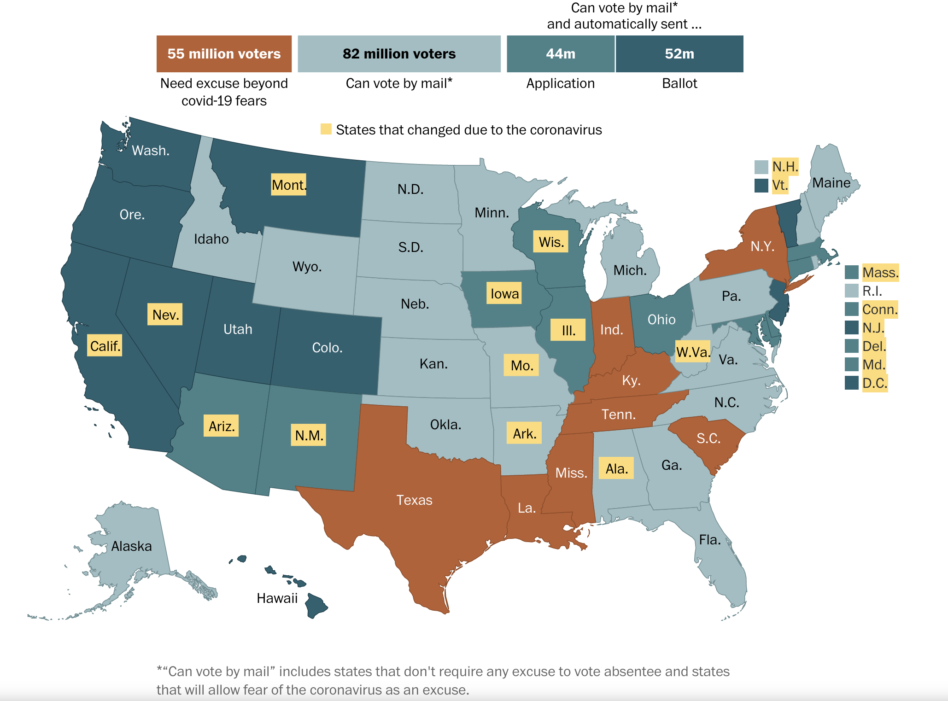
Source: Washington Post 8/20/20
Notes:
https://www.washingtonpost.com/graphics/2020/politics/vote-by-mail-states/

Slide 3
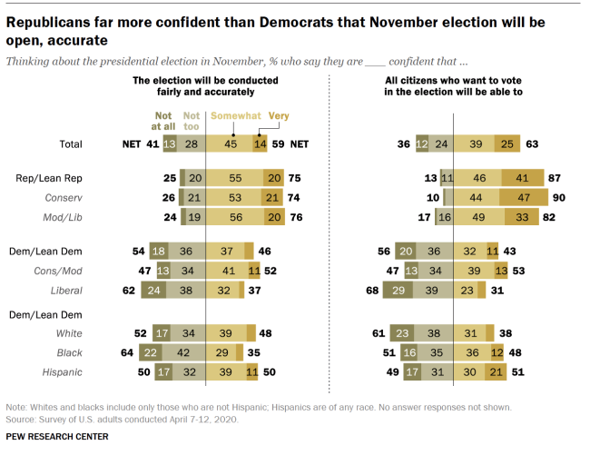

Slide 4
Notes:
https://theharrispoll.com/a-mass-exodus-from-american-cities-not-quite-poll/

